Slide 1
THREAT modelling
Eva Rodriguez, Saman Tariq
Task Force#1, Feb 2024

Slide 2
Attacks information
List of attacks that will be considered in HORSE are:
DNS amplification
DDoS signaling attack from SMF/UPF
API vulnerability protection e.g, RNAA attack, NEF expose 3GPP network capabilities via APIs

Slide 3
Attack #1: DNS Amplification
Attack Category | Attack Type | Traffic Protocol | Impact | Mitigation Approach | Affected Components | Affected Layer | Entry points | Framework
Denial-of-service | DNS Amplification | DNS, NTP | Services unavailable | Filter network traffic | SDN, NFV, RAN, Cloud and network services | Radio, Core network | SDN controller, AMF, DNS Server, network functions | MITRE ATT &CK
[Ref1] Farooqui, Muhammad Najmul Islam, Junaid Arshad, and Muhammad Mubashir Khan.
“A layered approach to threat modeling for 5G-based systems." Electronics 11.12 (2022): 1819.

Slide 4
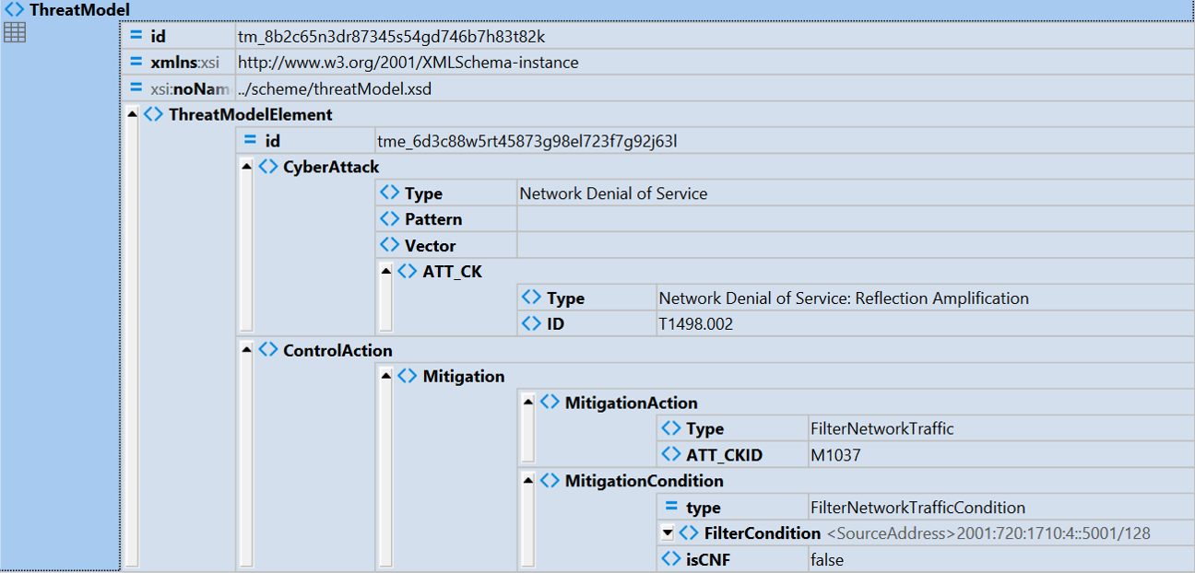
XML example – DNS amplification

Slide 5
Attack #2 DDoS Signaling
Attack Category | Attack Type | Traffic Protocol | Impact | ML model | Affected Components | Affected Layer | Entry points | Framework
Signaling threat | DDoS signaling | HTTP/2, PFCP | Unavailability, CN reach to overloaded state, services disruption | Naïve Bayesian, SVM, Random Forest | Network services, core network function, signaling server | Core Network | Server, network functions | ATLAS MITRE
 |  | RRC |  | Randomization |  | RAN | Server, network functions
 |  | RRC, SIP |  | CNN |  | Complex analysis
[ref2] Park, Seongmin, et al. "Machine Learning Based Signaling DDoS Detection System
for 5G Stand Alone Core Network." Applied Sciences 12.23 (2022): 12456.

Slide 6
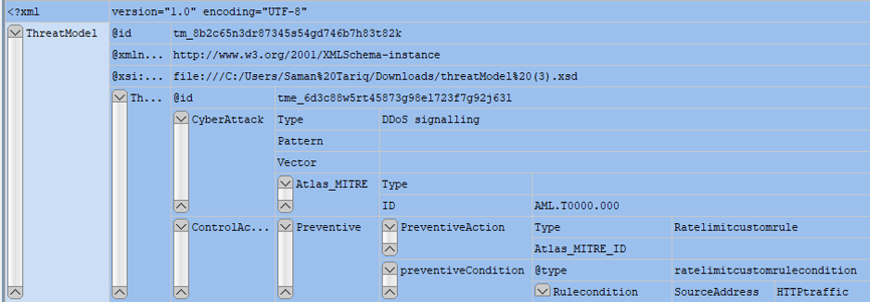
XML example – DDoS Signaling

Slide 7
Attack #3 RNAA Northbound API access. NEF expose 3GPP network capabilities via APIs
Attack Category | Attack Type | Traffic Protocol | Impact | Mitigation Action | Affected Components | Affected Layer | Entry points | Framework
API vulnerability (RNAA attack) | NEF Northbound API | HTTP, Restful API etc. | Unavailability of services, confidentiality, Integrity | Authentication & Authorization API instance authorized to specific end user network Enhanced security protocol features Such as Oauth2 or Mutual TLS Role-based access control Limiting access | Core network functions (AMF, SMF, UPF, PCF) | Service layer | External application, API gateway Server, network functions | 3GPP CAPIF
[ref 3] https://portal.3gpp.org/desktopmodules/Specifications/SpecificationDetails.aspx?specificationId=3337
[ref 4]Tang, Qiang, et al. "A systematic analysis of 5G networks with a focus on 5G core security." IEEE Access 10 (2022): 18298-18319.

Slide 8
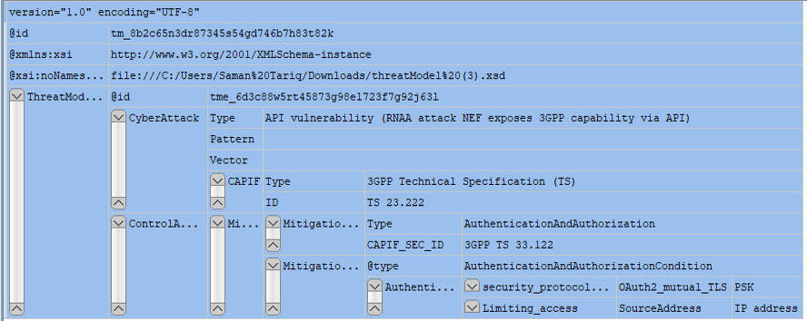
XML example – RNAA Northbound API access. NEF expose 3GPP network capabilities via APIs

